Slide 1

Mathematical modeling of thermochemical energy storage by salt hydrates
Review 2
STUDENT NAME:
DHANUSH T
KANCHAN GANDIGUDE
ROLL NO :
102120026
102120038
GUIDE NAME:
DR.JYOTI SAHU
ASST.PROFESSOR
DEPARTMENT OF CHEMICAL ENGINEERING
NATIONAL INSTITUTE OF TECHNOLOGY TIRUCHIRAPALLI - 620015

Slide 2
TABLE OF CONTENTS
1. INTRODUCTION
5. METHODOLOGY
6. RESULTS AND DISCUSSION
2. LITERATURE REVIEW
3. RESEARCH GAP
4. OBJECTIVES
7. WORK PLAN

Slide 3
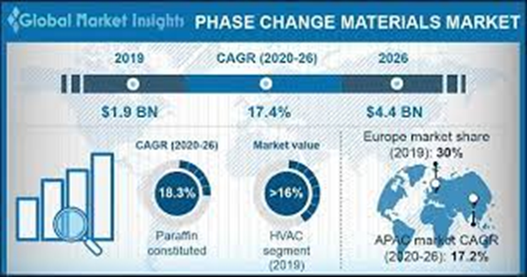
1. INTRODUCTION
LOW TEMP (-20 TO -5 C )
vaccine cold chain logistic , cold storage ,
MEDIUM TEMP (40-80 C)
domestic hot water generation ,
HIGH TEMP (80-200 C)
concentrated solar power plants ,
Phase change materials applications
MEDIUM LOW TEMP (5 TO 40 C)
heating and cooling in building ,
Fig 1 .
Fig 2.
Phase Change Material
Organic
Paraffin Compounds
Non-Paraffin Compounds
Inorganic
Salt Hydrate
Metallic
Eutectic
Organic – Organic
Inorganic – Inorganic
Inorganic – Organic
Fig 3 .

Slide 4
2. LITERATURE REVIEW
Our literature review includes works of various researchers like
M. Gaeini (2018), who studied thermochemical heat storage in salt hydrates.
Lin Liang (2017), who studied that a new cold storage phase change material eutectic hydrate salt (K2HPO4·3H2O–NaH2PO4·2H2O–Na2S2O3·5H2O) was prepared, modified, and tested.
Luca Scapino (2017) studied that sorption heat storage has the potential to store large amounts of thermal energy from renewables and other distributed energy sources.
Dongdong Li (2018) studied the development of a multi-temperature thermodynamically consistent model for Salt Lake brine systems.
Christoph Rathgeber (2019) worked on the modified BET equations that are extended to calculate solubility phase diagrams of concentrated salt solutions with relatively high-water activities within the range of under saturation.
And many more to add on.

Slide 5
2. LITERATURE REVIEW
Various Thermodynamic models are studied from literature.
Debye-Huckel equation
Davis Equation
Pitzer Equation
BET Model
Pitzer Simonson Clegg

Slide 6
1. Lack of experimental data at high temperature and pressure and validation.
2. Model accounting for salt hydrates at elevated temperature, pressure, and concentration.
3. Accounting of unstable chemical reactions.
4. Accounting of complex phase equilibria (vapor: liquid: solid).
3. Research gap and novelty

Slide 7
4. OBJECTIVE
1. Study of phase change of salt hydrates
2. Study of charging and discharging cycles
3. Study of capacity of batteries
4. Study of thermal management in batteries

Slide 8
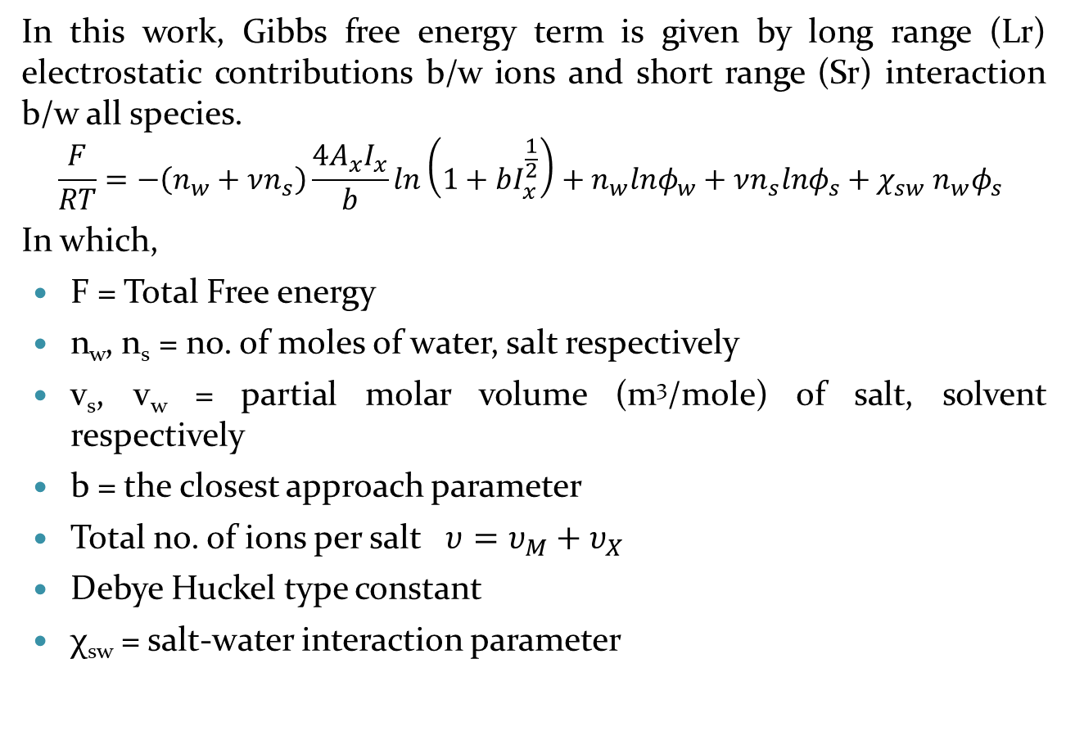
5. METHODOLOGY
In this work, Gibbs free energy term is given by long range (Lr) electrostatic contributions b/w ions and short range (Sr) interaction b/w all species.
$$\frac{F}{RT}=−\left(n_{w}+νn_{s}\right)\frac{4A_{x}I_{x}}{b}ln\left(1+bI_{x}^{\frac{1}{2}}\right)+n_{w}lnφ_{w}+νn_{s}lnφ_{s}+χ_{sw} n_{w}φ_{s}$$
In which,
F = Total Free energy
n_{w}, n_{s} = no. of moles of water, salt respectively
v_{s}, v_{w} = partial molar volume (m³/mole) of salt, solvent respectively
b = the closest approach parameter
Total no. of ions per salt $υ=υ_{M}+υ_{X}$
Debye Huckel type constant
χ_{sw} = salt-water interaction parameter

Slide 9
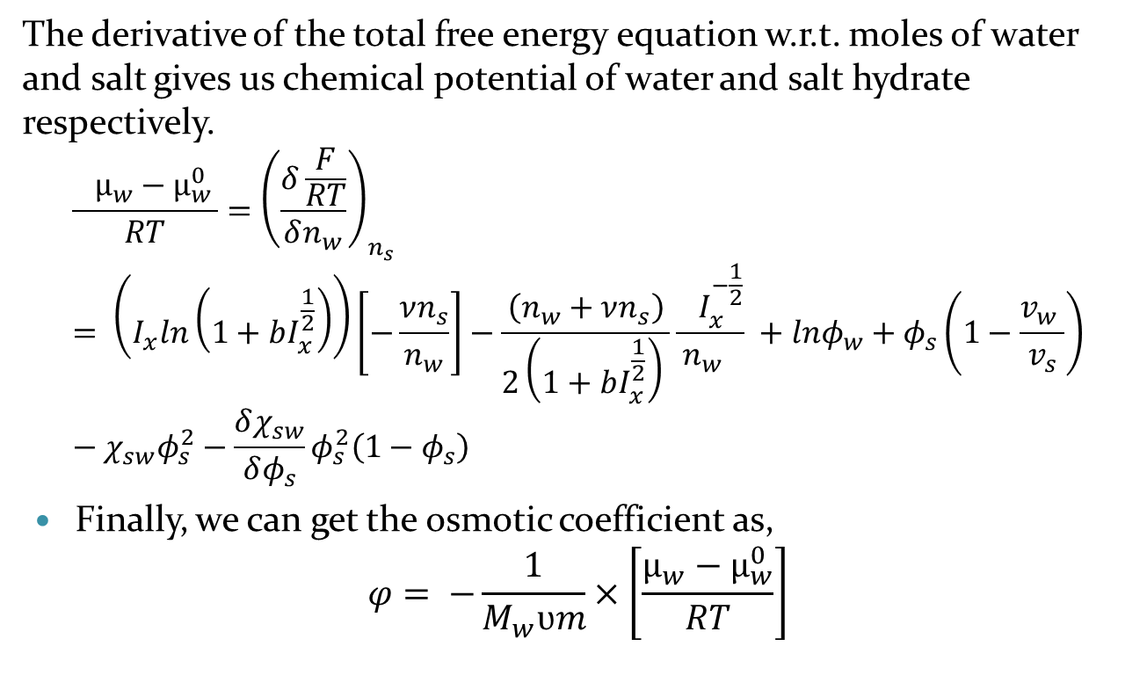
5. Methodology
The derivative of the total free energy equation w.r.t. moles of water and salt gives us chemical potential of water and salt hydrate respectively.
$$\frac{{ µ_{w}−µ}_{w }^{0}}{RT}={\left(\frac{δ\frac{F}{RT}}{δn_{w}}\right)}_{n_{s}}= \left(I_{x}ln\left(1+bI_{x}^{\frac{1}{2}}\right)\right)\left[−\frac{νn_{s}}{n_{w}}\right]−\frac{\left(n_{w}+νn_{s}\right)}{2\left(1+bI_{x}^{\frac{1}{2}}\right) }\frac{{ I}_{x}^{−\frac{1}{2}}}{n_{w} } +lnφ_{w}+φ_{s}\left(1−\frac{v_{w} }{v_{s}}\right)−χ_{sw}φ_{s}^{2}−\frac{δχ_{sw}}{δφ_{s}}φ_{s}^{2}\left(1−φ_{s}\right)$$
Finally, we can get the osmotic coefficient as,
$$φ= −\frac{1}{M_{w}ʋm}×\left[\frac{µ_{w}−µ_{w}^{0}}{RT}\right]$$

Slide 10
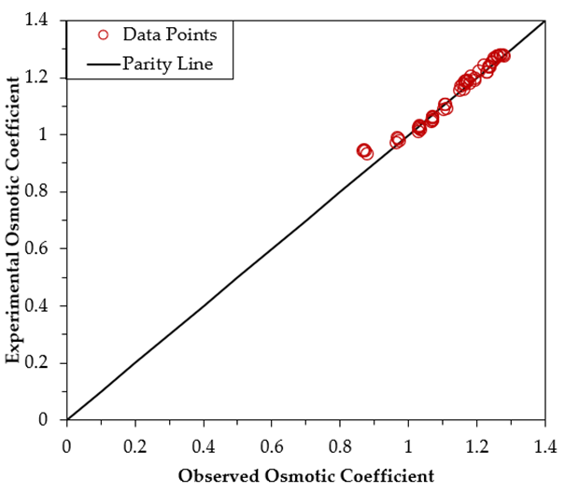
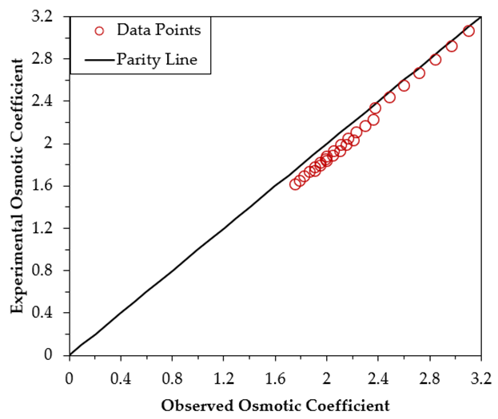
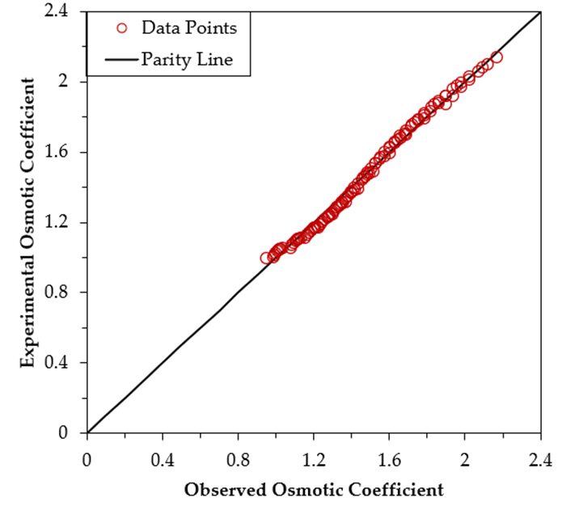
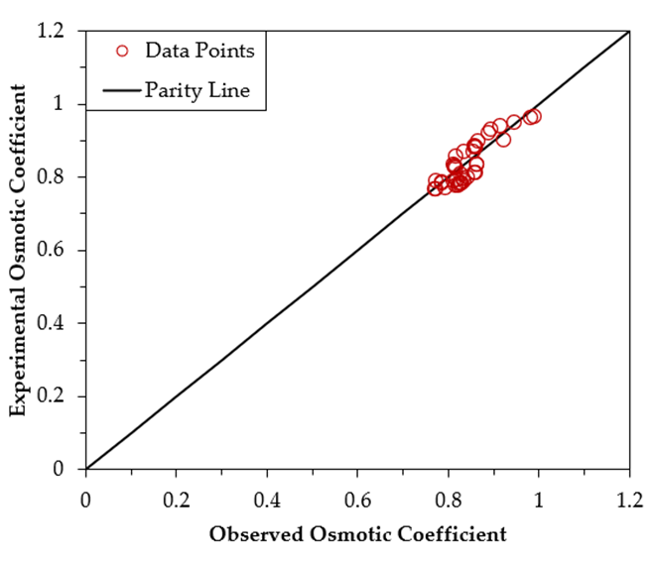
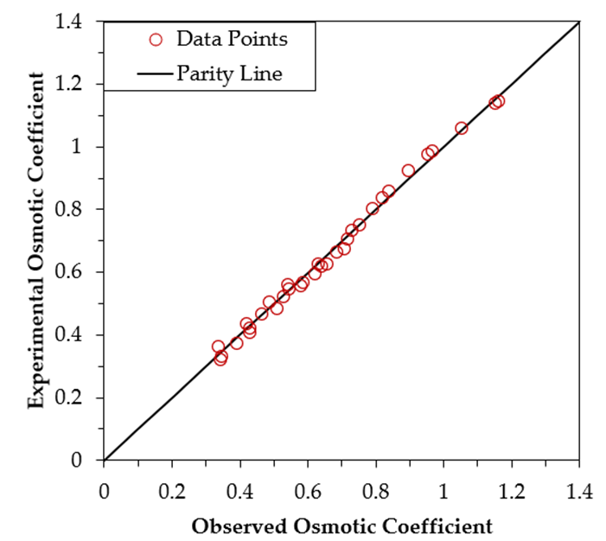
6. RESULTS AND DISCUSSION
Parity plot for n=3
Fig 1: NaCl
Fig 2: LiCl
Fig 3: CaCl2
Fig 5 :MgSO4
Fig 4: Li2SO4

Slide 11
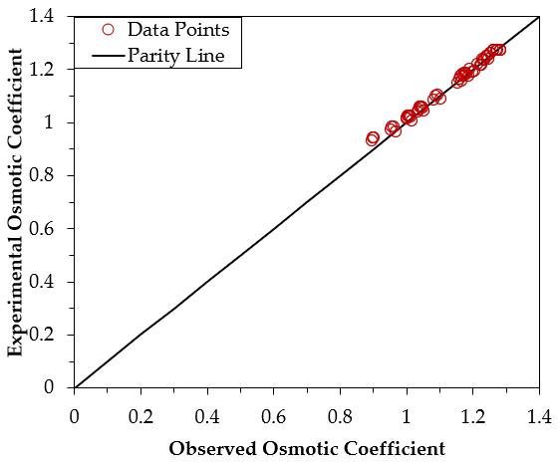
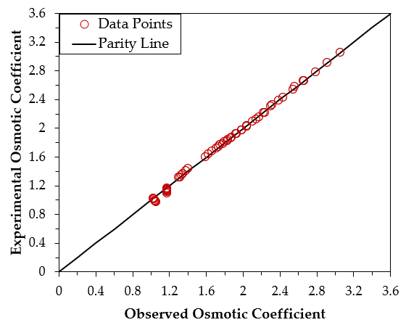
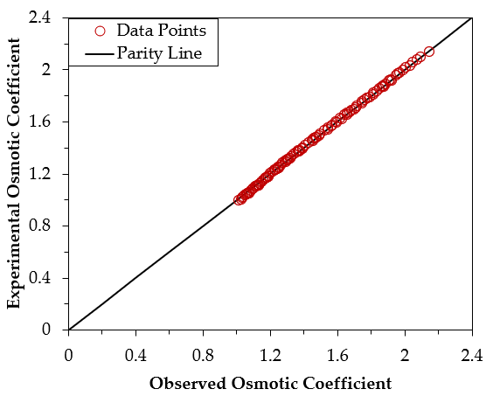
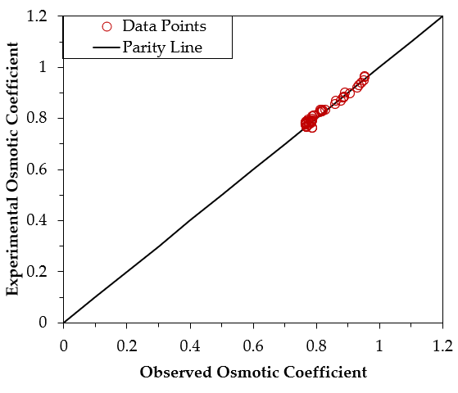
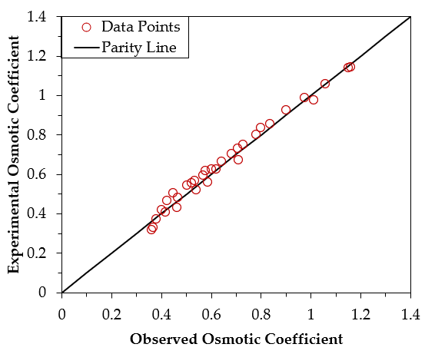
Parity plot for n=4
Fig 1: NaCl
Fig 2: LiCl
Fig 3: CaCl2
Fig 4: Li2SO4
Fig 5 :MgSO4

Slide 12
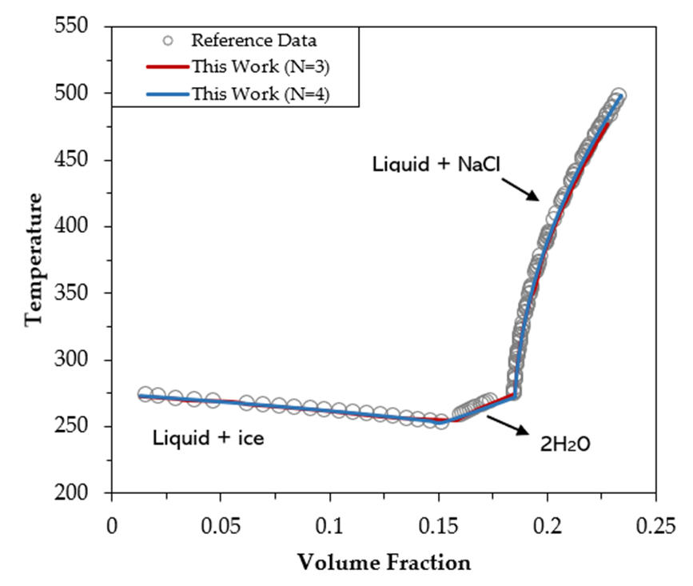
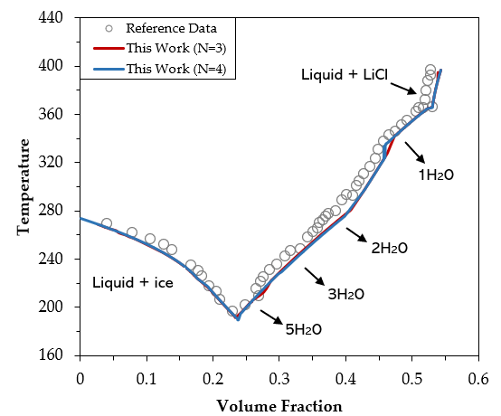
Phase diagram graphs for n=3 and n=4
Fig 2: LiCl
Fig 1: NaCl

Slide 13
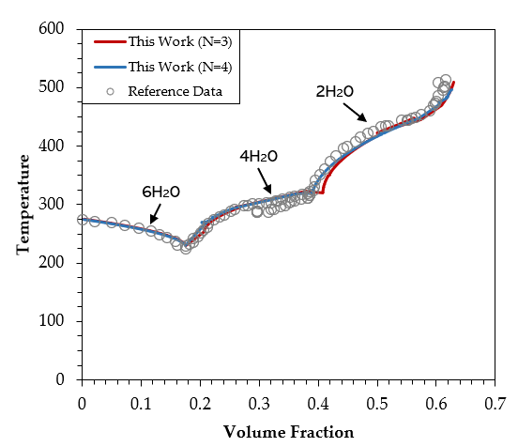
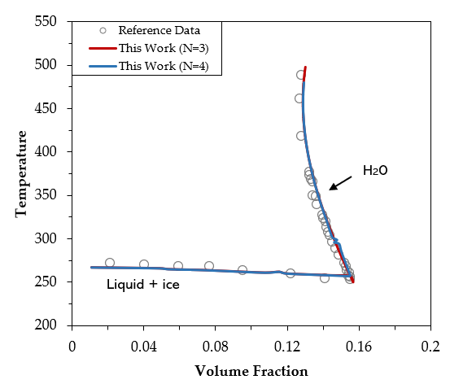
Phase diagram graphs for n=3 and n=4
Fig 4: Li2SO4
Fig 3: CaCl2

Slide 14
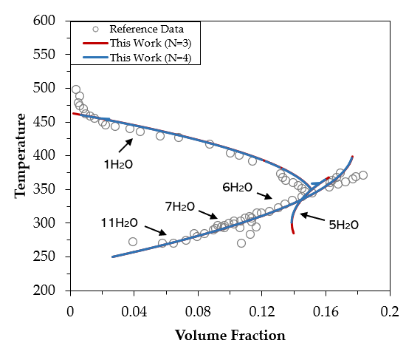
Phase diagram graphs for n=3 and n=4
Fig 5 :MgSO4

Slide 15
7. WORK PLAN
Work done till now :
1. Literature reviews
2. Developed a mathematical model for various salt hydrates
3. Solve the model for various salt hydrates
4. Draft of our work is ready in form of research article
5. Extend our model for mixer of salt hydrates and eutectic salts
6. Submit our work in renowned journal
Work plan for future :

Slide 16
! THANK YOU !

